Slide 1
CSS Box Model
Every element that can be displayed on a web page is comprised of one or more rectangular boxes.
CSS box model typically describes how these rectangular boxes are laid out on a web page.
These boxes can have different properties and can interact with each other in different ways, but every box has a content area and optional surrounding padding, border, and margin areas.

Slide 2
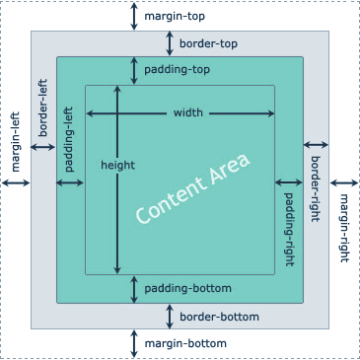
CSS Box Model(contd.)

Slide 3
CSS Padding Properties
Define Paddings for Individual Sides
You can specify the paddings for the individual sides of an element such as top, right, bottom, and left sides using the CSS padding-top, padding-right, padding-bottom, and the padding-left properties, respectively.
The Padding Shorthand Property
The padding property is a shorthand property to avoid setting padding of each side separately, i.e., padding-top, padding-right, padding-bottom and padding-left.

Slide 4
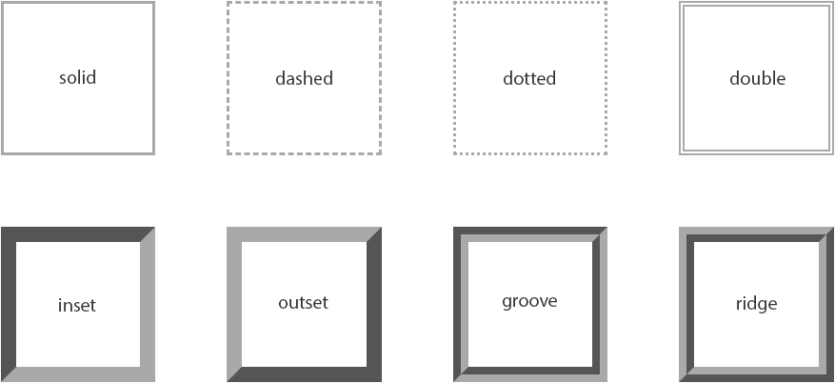
CSS Border Properties
Borders appear directly between the margin and padding of an element.

Slide 5
CSS Margin Properties
Setting Margins for Individual Sides
You can specify the margins for the individual sides of an element such as top, right, bottom, and left sides using the CSS margin-top, margin-right, margin-bottom, and the margin-left properties, respectively.
The Margin Shorthand Property
The margin property is a shorthand property to avoid setting margin of each side separately, i.e., margin-top, margin-right, margin-bottom and margin-left.

